Slide 1
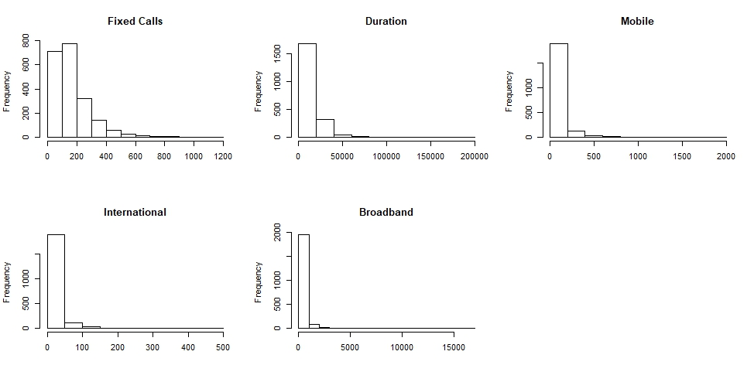
Describe Data
par(mfrow=c(2,3))
hist(phoneRawData$Fixed.Calls,main="Fixed Calls",xlab="")
hist(phoneRawData$Duration,main="Duration",xlab="")
hist(phoneRawData$Mobile,main="Mobile",xlab="")
hist(phoneRawData$International,main="International",xlab="")
hist(phoneRawData$Broadband,main="Broadband",xlab="")
par(mfrow=c(1,1)) #Reset graph window

Slide 2
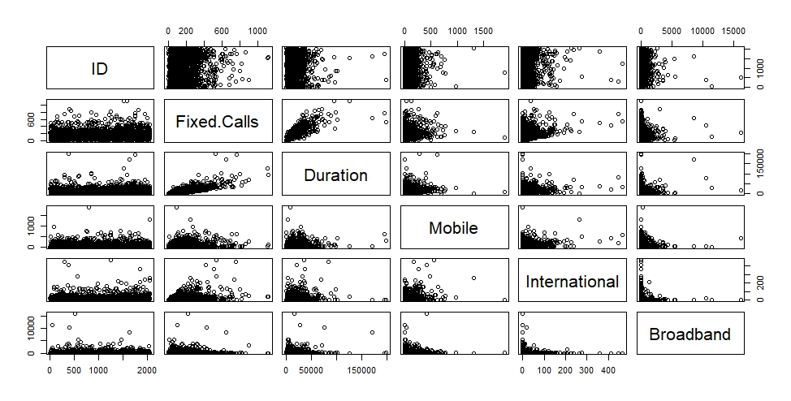
Raw Data Inspection
plot(phoneRawData)

Slide 3
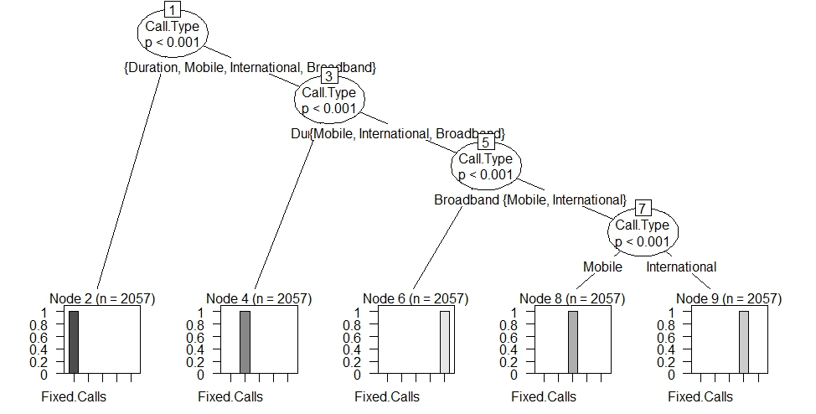
Build Tree
phoneDataPivot <- gather(phoneRawData,key=Call.Type,value="Length",Fixed.Calls,Duration,Mobile,International,Broadband,-ID,factor_key=TRUE)
phoneTree <- ctree(Call.Type ~ Call.Type, data=phoneDataPivot)
plot(phoneTree, las=2)

Slide 4
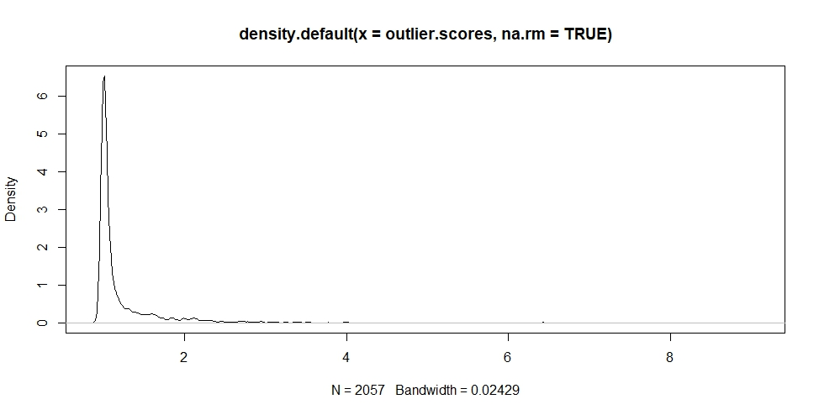
Outliers
phoneData <- select(phoneRawData,Fixed.Calls,Duration,Mobile,International,Broadband)
# Individual variable outliers
# Fixed Calls
boxplot.stats(phoneData$Fixed.Calls)$out
# Duration
boxplot.stats(phoneData$Duration)$out
# Mobile
boxplot.stats(phoneData$Mobile)$out
# International
boxplot.stats(phoneData$International)$out
# Broadband
boxplot.stats(phoneData$Broadband)$out
# Multi-variant outlier detection
outlier.scores <- lofactor(phoneData, k=10)
plot(density(outlier.scores, na.rm=TRUE))
# Top Multi-variant Outliers
outliersOrdered <- order(outlier.scores, decreasing=T)[1:100]
# Location of the top outliers
outliersOrdered
phoneData.outliersRemoved <- phoneData[-outliersOrdered,] # Not used but kept as an example

Slide 5
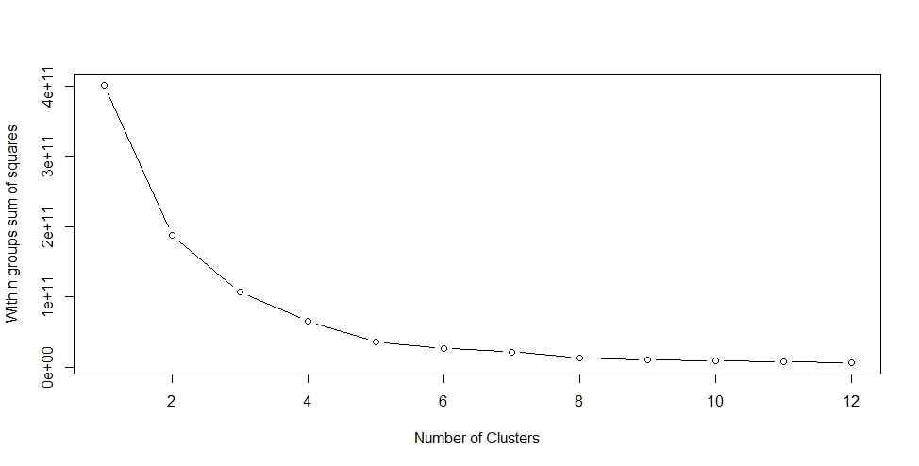
PCA Factoring
wssplot <- function(wssData, numClust=12, seed=12345){
wss <- (nrow(wssData)-1)*sum(apply(wssData,2,var))
for (i in 2:numClust){
set.seed(seed)
wss[i] <- sum(kmeans(wssData, centers=i)$withinss)
}
plot(1:numClust, wss, type="b", xlab="Number of Clusters", ylab="Within groups sum of squares")
}
# Run PCA analysis to identify variables for clustering
model <- prcomp(phoneData,center=TRUE, scale = TRUE)
summary(model)
plot(model,main="",col="blue")
biplot(model,scale=0, cex=.7)
pairs(phoneData)
# Remove Broadband & International
phoneDataScale <- select(phoneData,Fixed.Calls,Duration,Mobile)
# Estimate the number of clusters for Kmeans
wssplot(phoneDataScale)

Slide 6
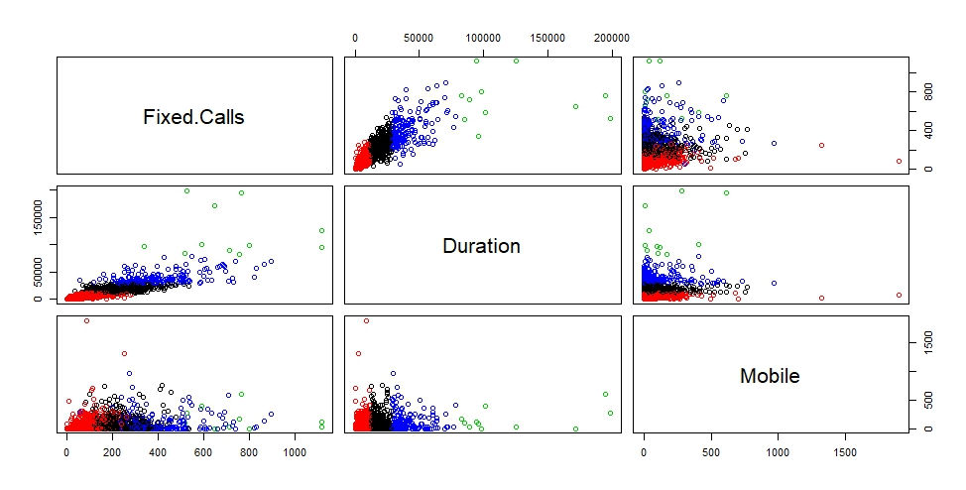
After Clustering
# Create clusters
(clust <- kmeans(phoneDataScale, 4))
plot(phoneDataScale, col = clust$cluster) # Visually check clusters
points(clust$centers, col = 1:4, pch = 8, cex = 2)
# Add cluster data to the phone data
phoneDataCluster <- cbind(phoneRawData,clust$cluster)
# Fix clust$cluster name
colnames(phoneDataCluster) <- c(names(phoneRawData[1,1:6]),"Cluster")
head(phoneDataCluster)

